Slide 1
Region Based Segmentation
Find regions directly via pixel inspection.
  Region Growing Algorithm.
  Split and Merge Algorithm.

Slide 2
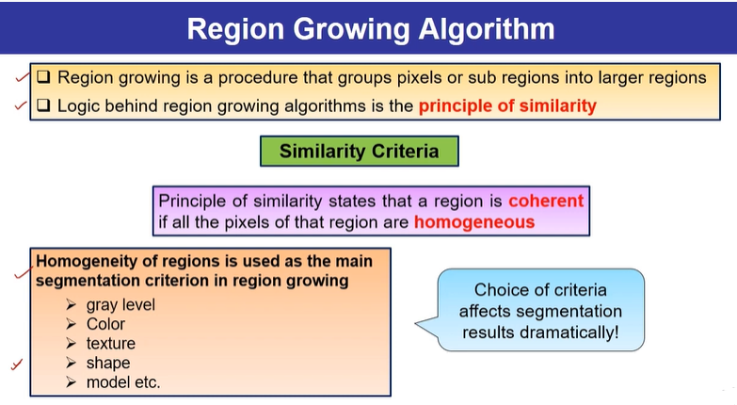

Slide 3
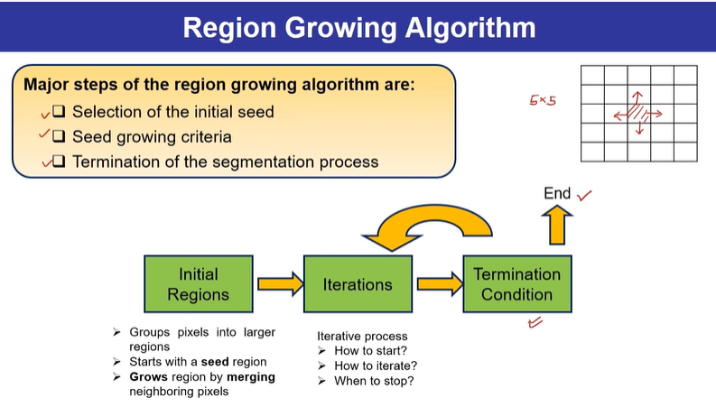

Slide 4
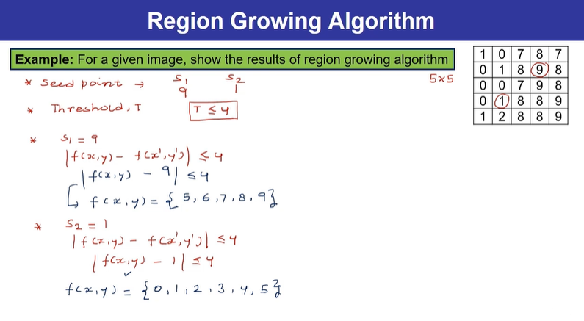

Slide 5
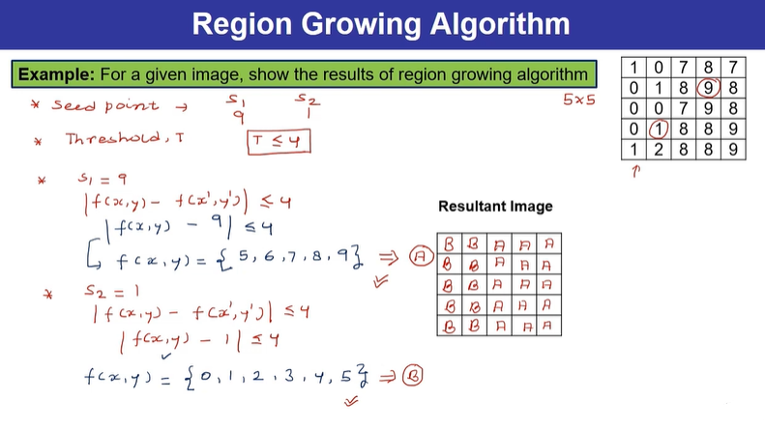

Slide 6
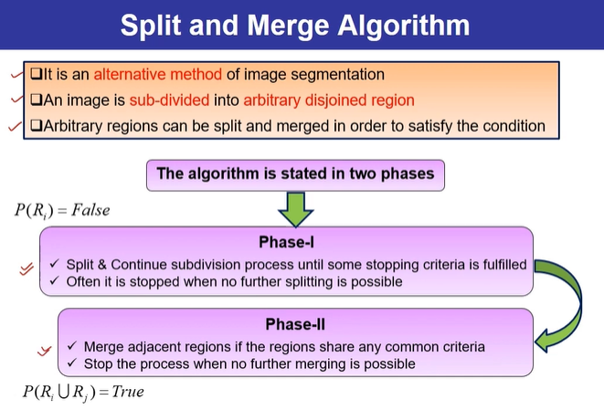

Slide 7
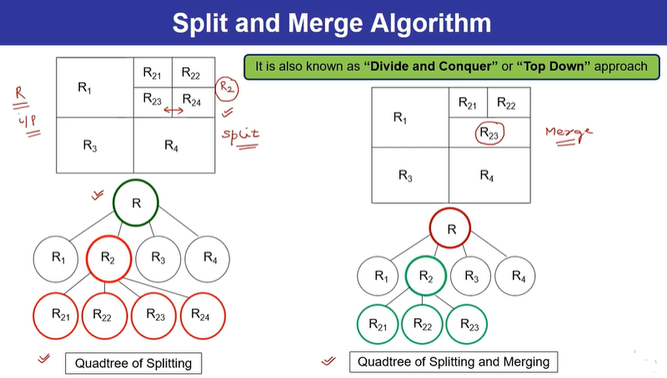

Slide 8
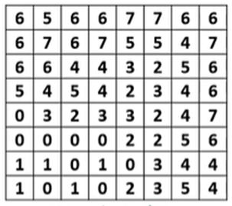

Slide 9
